Slide 1
PSO及其應用
黃俊傑(Huang Chun-Chieh)

Slide 2
Standard PSO
v_{i}(t+1) = ωV_{i}(t) + c_{1 ˙} r_{1 ˙}( p_{i}(t) - x_{i}(t) ) + c_{2 ˙} r_{2 ˙}( p_{g}(t) - x_{i}(t) )#
x_{i}(t+1) = x_{i}(t) + v_{i}(t+1)#
Where
V:速度, X:位置, ω:慣性權重, p_{i}:粒子i最好的位置, p_{g}:全域最好的位置, c₁:個體權重, c₂:群體權重, r₁:Random[0,1], r₂:Random[0,1]#

Slide 3
Inertia weight : ω
(1).文獻指出ω對PSO的性能影響很大.
Statistic analysis on parameter efficiency of particle swarm optimization
(2).大ω有利於全域探索；小ω反之.
(3). ω分為靜態與動態
動態的有
線性遞減, 非線性遞減, Fuzzy, Random

Slide 4

Def PSO
func:目標函數(Objective Function)
lb:變數下限, ub:變數上限. i.e.
f_ieqcons:約束函數. i.e.
args:常數項. i.e.
swarmsize:粒子數(100), omega:慣性權重(ω=0.5), phip=c₁(0.5), phig=c₂(0.5), maxiter, minstep, minfunc.
x=[30(lb),70(ub)]
Result >= 400
x1 * C₈₇₆₃ , 其中 C₈₇₆₃ = 486

Slide 5
Function(1)

Slide 6

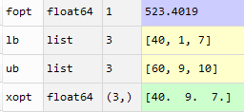
Function(1)
min f(x) = 2.5-0.145x₁-0.0359x₂-0.124x₁x₂+0.24x₁x₃+0.284x₁²+0.24x₂² +0.625x₃² #
X=[x₁,x₂,x₃]
40≦x₁ ≦60
1≦x₂ ≦9
7≦x₃ ≦10
CPSO:
xopt=[40,8.99,7] , fopt = [523.4087]

Slide 7
Function(2)

Slide 8


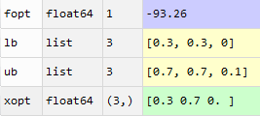

Function(2)
max f(x) = 118.79 – 85.1x₁-85.1x₃+2689.7x₃²-678.1x₁x_{3#}
0.3≦x₁ ≦0.7
0.3≦x₂ ≦0.7
0≦x₃ ≦0.1
X=[x₁,x₂,x₃]
x₁+x₂+x₃ = 1.00
CPSO:
xopt=[0.3, 0.6, 0.1] , fopt = [91.304]

Slide 9
Function(3)

Slide 10
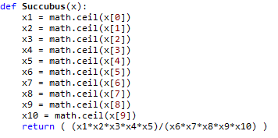
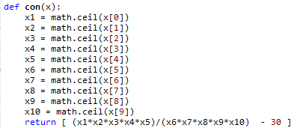
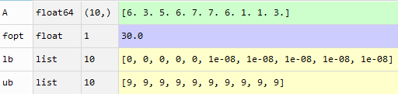
Function(3)
(口*口*口*口*口*)/(口*口*口*口*口 )= 30 , 口可填0~9

Slide 11
Function(4)

Slide 12
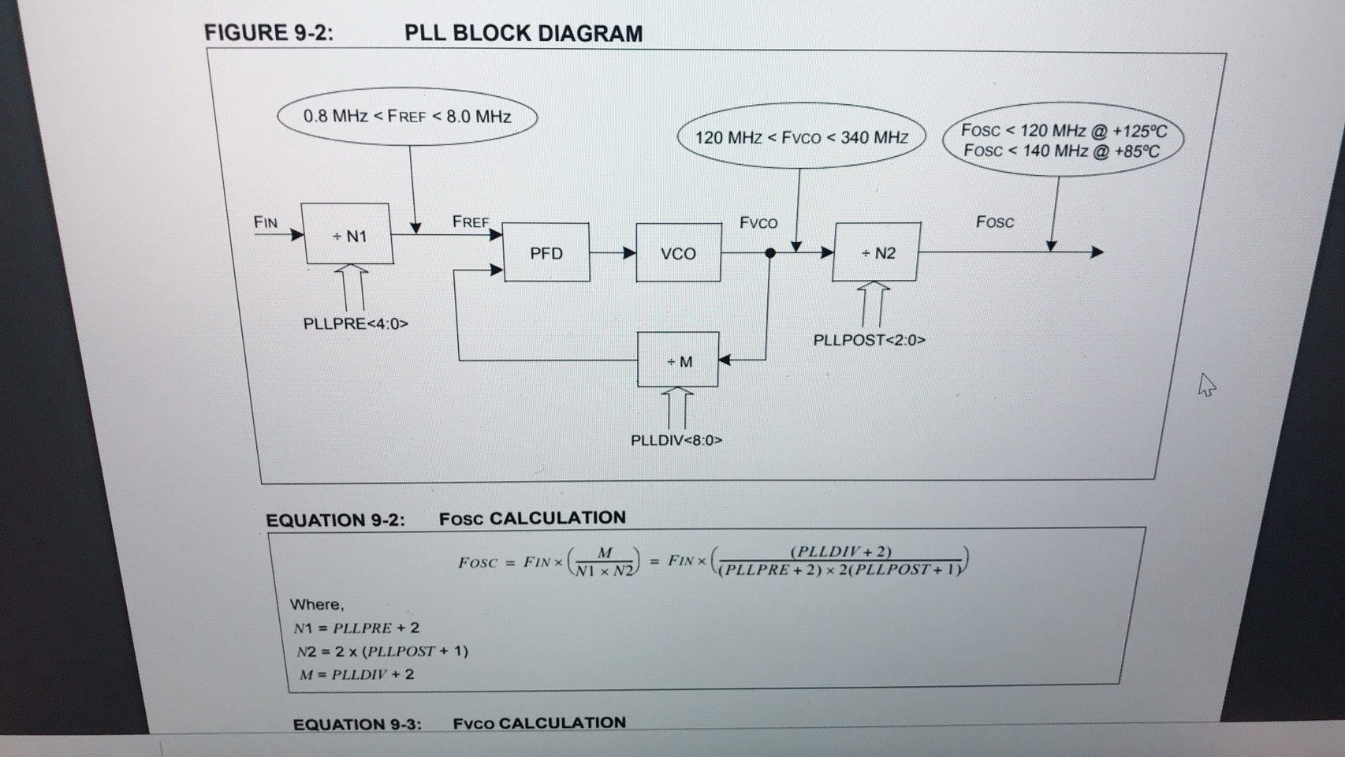
Function(4)

Slide 13

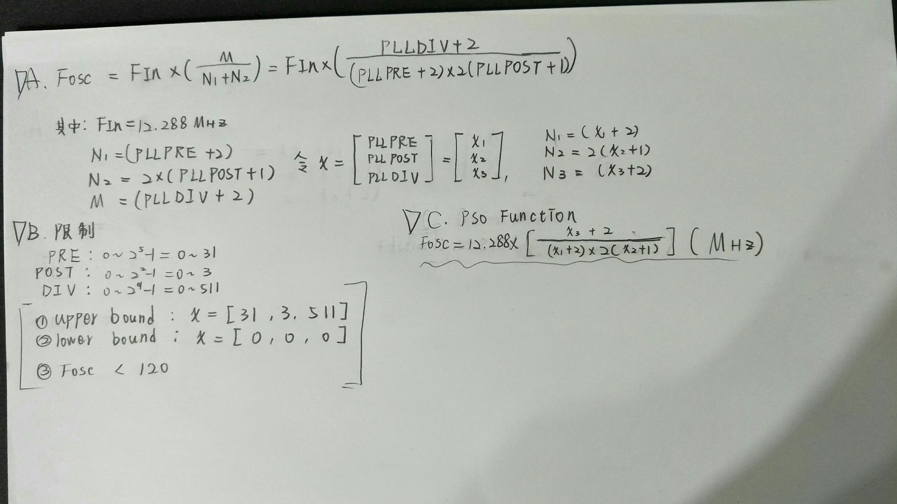

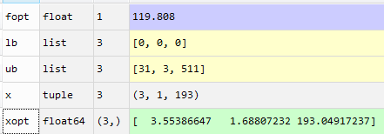



Slide 14
Function(5)

Slide 15
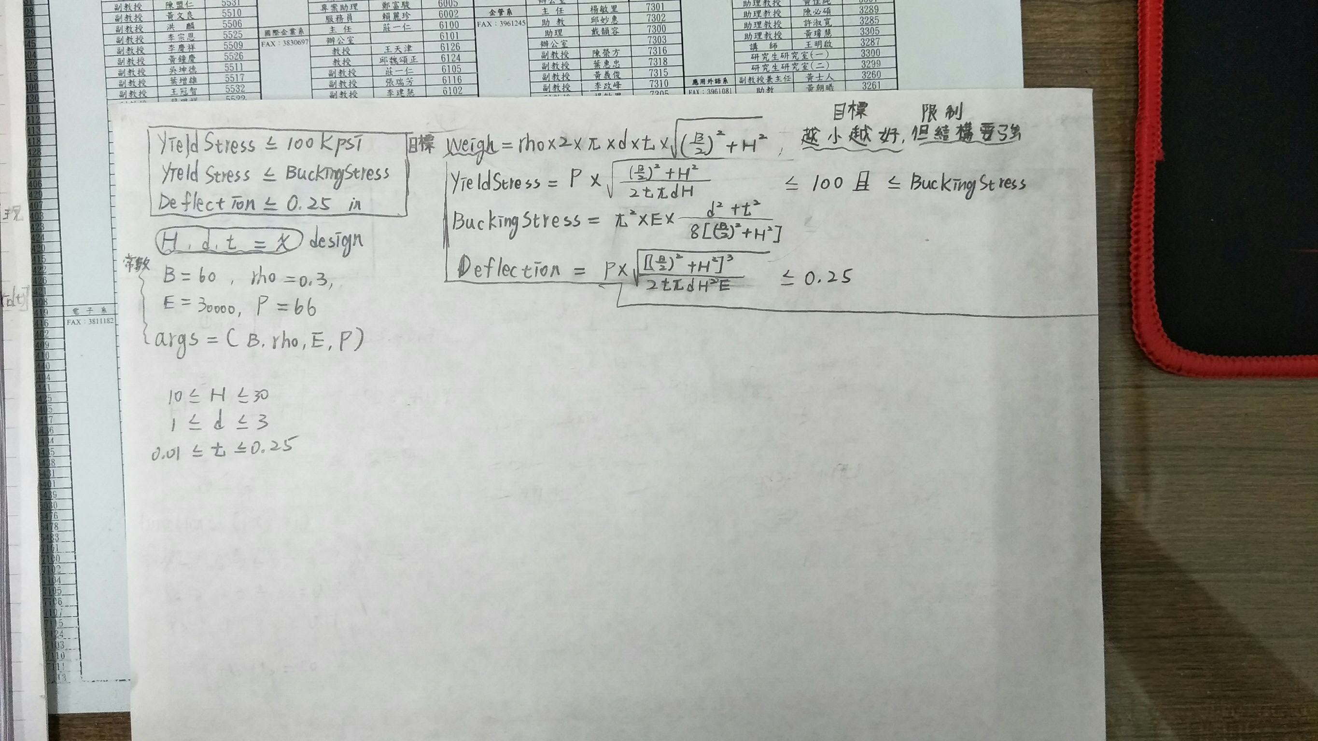

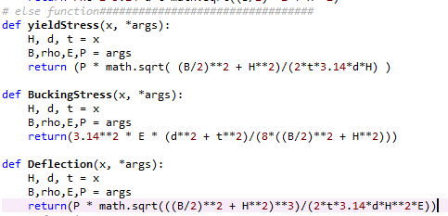
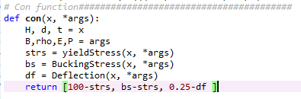
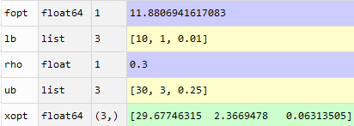


Slide 16

Thanks for your attention

